Slide 1
CURRENT CONTROLLED PWM INVERTERS
References
Modern power Electronics and AC Drives by B K Bose
Modern power Electronics Evolution, Technology and Application
By B K Bose

Slide 2
Problems associated with voltage controlled inverters
PWM output voltage waveform causes current ripple. This increases motor losses.
Extra current rating is required for devices.
A small unbalance in motor phase voltage leads to relatively large unbalance in motor current.
This causes extra heating and torque ripple in motor output.
Such constraints lead to high degree of precision for a fairly smooth sinusoidal waveform generation.

Slide 3
In drive systems, flux and developed torque depends on current and hence current control is important.
Objectives of Current Control Scheme:
Minimization of motor losses so that conventional motors can be used without derating.
Minimization of peak device current.
Simplification of control scheme to reduce cost.
These objectives can be met with independent current
control on each inverter output phase

Slide 4
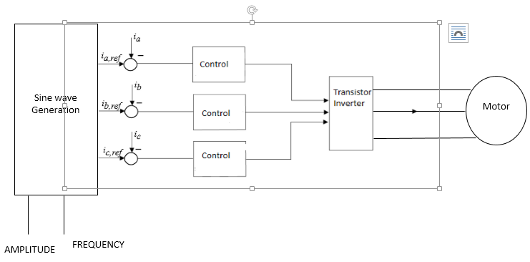
Reference sine wave at the desired output frequency and proportional to desired current amplitude is generated.
Actual motor current is compared with these reference waveforms.
If T_{A+} is on and the motor current is positive and more than the reference,
T_{A+} is turned off and T_{A-} is turned on.
But the positive load current flows through D_{A-} and lower source.
Current magnitude decreases.
When load current becomes lower than reference value, T_{A+} is turned on and current magnitude increases.

Slide 5
i_{a ref}
i_{a}

Slide 6
problem associated with this scheme is the maximum operating frequency of the inverter.
Inverter losses are proportional to frequency and must be limited.
This can be achieved by introducing a small amount of hysteresis into the comparator.

Slide 7
Hysteresis Band Current Controlled PWM
Hysteresis band PWM is a current feedback control method of PWM.
actual current track the command current within a hysteresis band.
The control circuit generates the sine reference current wave of desired magnitude and frequency.
It is compared with actual phase current wave.

Slide 8
i₀*
i_{o}
V_{o}
V_{d}^{/2}
D_{A-}
D_{A+}
D_{A+}
T_{A+}
T_{A-}
T_{A-}
During positive half cycle of load current, T_{A+} conducts and i₀ rises. When the current exceeds a prescribed hysteresis band then T_{A+} is turned Off and lower switch is turned ON.
But D_{A-} conducts. i₀ decreases
As the current crosses the lower band limit, the upper switch T_{A+} is turned on again.
The output voltage changes from -0.5 V_{d} to +0.5 V_{d} and the load current starts to rise.

Slide 9
When V_{n} < V_{p}, V₀ = +V_{sat}
When V_{n} > V_{p}, V₀ = - V_{sat}
V_{n}
V₀
V_{p}

Slide 10
When T_{A}⁺ is on, current rises
When D_{A}⁻ is on, T_{A}⁺ is off

Slide 11
Switching period of T_{A}⁺ is
Switching frequency
For a fixed tolerance band of current ΔI, switching frequency f_{s} depends on back emf E_{c}

Slide 12
When E_{c} = 0, f_{s} is maximum
Switching frequency
When E_{c} varies sinusoidally, E_{c} = m sinωt

Slide 13
For a fixed tolerance band ΔI, switching frequency f_{s} varies with time around an average value at a frequency twice as that of the back emf E_{c}
ΔI is selected such that f_{s} remains in the permitted value of the device.

Slide 14
Factors that influence switching frequency:
Induced counter emf of the load
Dc bus voltage
Current ripple.
Effect of DC voltage limit:
There must be sufficient input dc source potential to force line currents in the desired direction.
For low values of load back emf, magnitude of input dc source potential is not critical.
For high motor speed (large value of back emf E_{C}) the inverter must be capable to command the desired current.

